Slide 1
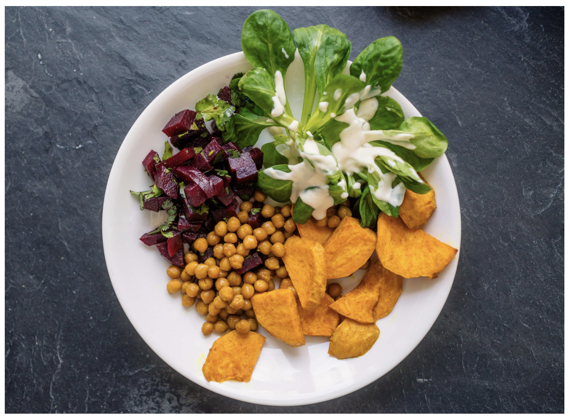
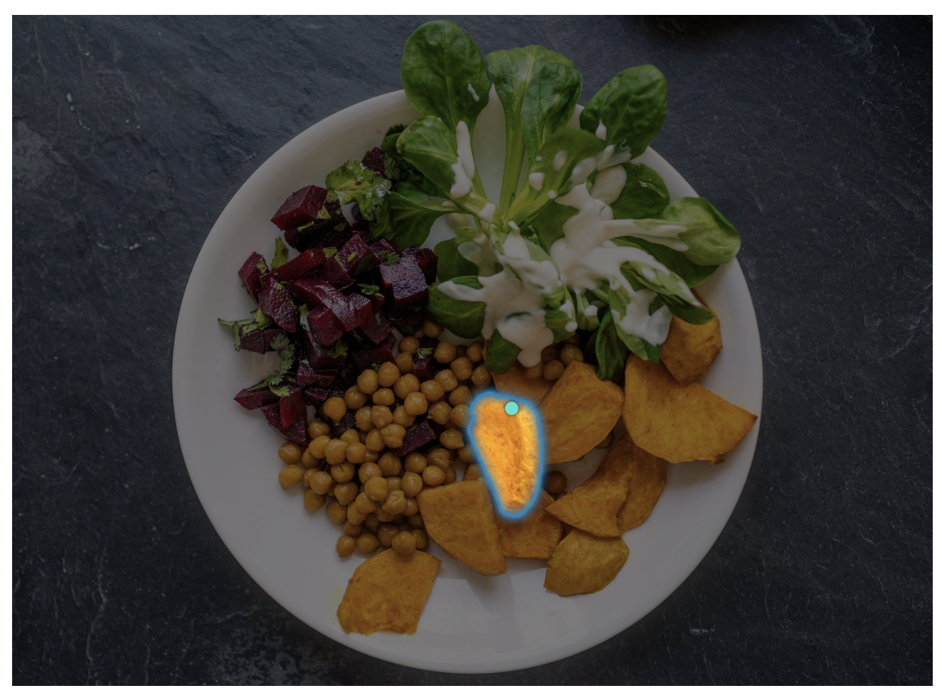
Project Title
Team Name
Caizhuangzhou Cui (z5509061)
Zihan Chen(z5527498)
Hefei Fu(z5597779)
Tingyuan Liu(z5565888)
Yankun Wei (z5528317)

Slide 2
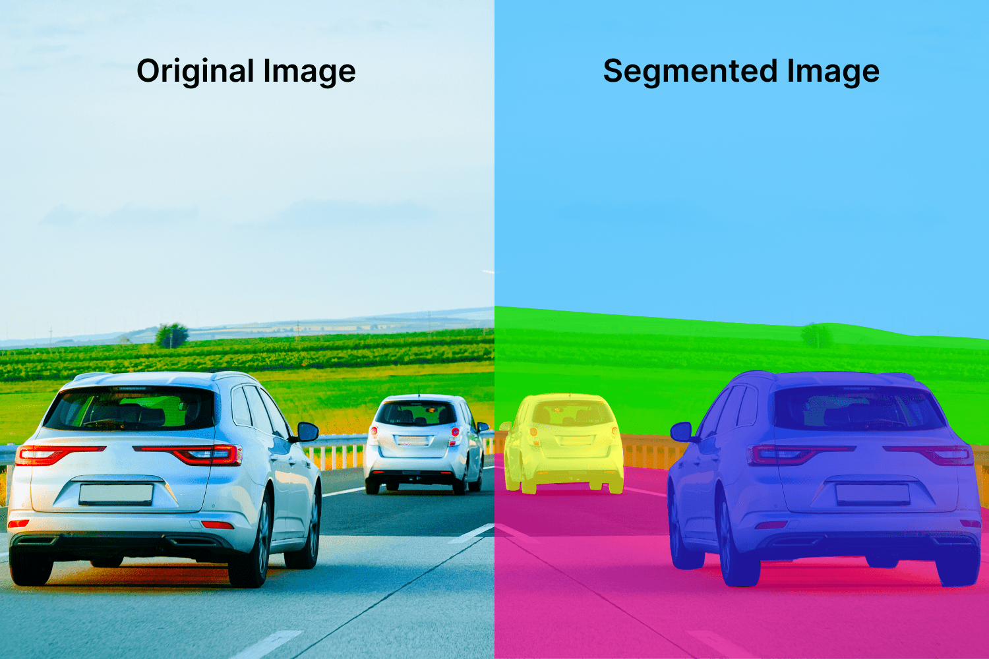
Motivation
This is just an example, please change images and content as per the project. Also, change Presenter’s name and zID for the final project presentation
Image Segmentation: Identifying which image pixels belong to an object
One of the core tasks in computer vision
Broad array of applications:
Medical Image Analysis
Scientific imagery
Editing photos
Autonomous Vehicles
Robotics
Agriculture
…
Presenter: Sonit Singh (zxxxxxxx)

Slide 3
Problem Statement
Write here
Presenter: Hugh Wilson (zxxxxxxx)

Slide 4
Literature Review
3. Fake News Detection Methods
Detection methods are categorized into traditional machine learning, deep learning, and credibility assessment.
3.1 Traditional Machine Learning
Early approaches relied on linguistic features (e.g., TF-IDF, sentiment polarity), using classifiers like SVM, Naïve Bayes, and Random Forest. Mushtaq et al. (2025) found Naïve Bayes achieved 99% accuracy on LIAR. However, these models struggle with long-form content and require handcrafted features, limiting generalization.
1. Introduction
With the rapid expansion of social media and digital news platforms, the proliferation of fake news has become a significant societal challenge. The ease of sharing information online has allowed misinformation and disinformation to spread rapidly, often influencing public opinion, political decisions, and social stability. In response, researchers have developed various methods to detect fake news, leveraging natural language processing (NLP), machine learning, and deep learning. This survey provides a comprehensive review of the latest developments in fake news detection, focusing on benchmark datasets, classification models, credibility assessment, and challenges faced in the field.
2.Benchmark Datasets for Fake News Detection
Fake news detection relies on benchmark datasets, with the LIAR dataset (Wang, 2017) being a widely used resource containing 12,836 statements labeled with truthfulness categories and metadata like speaker credibility. Other datasets include ISOT, which classifies articles as fake or real, and KDnugget, which provides large-scale data for deep learning. However, many datasets focus on political news, neglecting areas like health misinformation and financial fraud. Dataset biases, such as reliance on fact-checking sites, may also impact model generalizability.
Presenter: Hugh Wilson (zxxxxxxx)

Slide 5
Literature Review
4. Key Challenges
4.1 Evolution of Fake News
Fake news spans politics, health, finance, and AI-generated misinformation (e.g., deepfake text), complicating detection.
4.2 Explainability and Trust
Deep learning models lack interpretability. Srba et al. (2024) suggested credibility signal analysis for transparency, though efficiency is a concern.
4.3 Scalability and Computational Cost
Real-time detection on large-scale social media is challenging. Surjeet et al. (2025) proposed Apache Spark for scalability, but balancing model complexity and efficiency remains difficult.
3.2 Deep Learning Models
Deep learning captures complex text patterns, improving detection accuracy. Key models include:
CNNs (Wang, 2017) integrating text and metadata.
LSTM for sequential data analysis.
Hybrid models (Jiang et al., 2021) combining CNNs, LSTMs, and machine learning, achieving 96-99% accuracy.
Boosting algorithms (Balaji et al., 2024) using XGBoost and Hidden Markov Models. Challenges include high computational costs, poor interpretability, and AI-generated misinformation.
3.3 Credibility Assessment & Large Language Models (LLMs)
LLMs like BERT and GPT shift focus from binary classification to credibility assessment, evaluating factuality, bias, persuasion techniques, and source verification. Srba et al. (2024) emphasized the importance of credibility signals for transparency, while Surjeet et al. (2025) showed that BERT outperforms traditional models. However, LLMs require significant computational resources.
Presenter: Hugh Wilson (zxxxxxxx)

Slide 6
Dataset(s)
Provide details about the dataset or the RL tasks
Presenter: Hugh Wilson (zxxxxxxx)

Slide 7
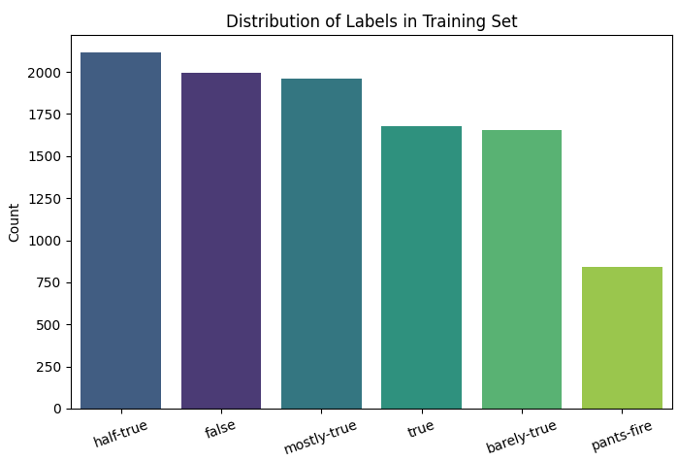
Data Analysis - LIAR Dataset
Data Format
TSV files containing political statements
12,836 samples, 6 classes
Sample distribution of categories
False: 2,638
Half-True: 2,636
Mostly-True: 2,063
True: 2,165
Barely-True: 2,276
Pants-Fire: 1,050
The category distribution is relatively balanced,
but the "Pants-Fire" category is relatively small, with only 1,050 entries.
Data diversity
Diverse topics: covering politics, economy, technology, health and other fields.
Diverse spokespersons: including government officials, experts, public figures, and ordinary people.
Diverse text length: from short sentences to complete statements.
Most news texts are between 10 and 50 words long.
Very few news texts are less than 5 words or more than 100 words.
Stop word problem: some texts contain a lot of meaningless words such as "the", "a", "of", etc.
Physical features
All text data
Mostly short texts (10-50 words on average)
Speakers from different topics, sources, and political backgrounds
Presenter: Zihan Chen(z5527498)

Slide 8
Method(s)
Details here …
Presenter: Zhongsui Guo (zxxxxxxx)

Slide 9
Results
Details here …
Presenter: Zhongsui Guo (zxxxxxxx)

Slide 10
Discussion
Details here …
Presenter: Zhongsui Guo (zxxxxxxx)

Slide 11
Conclusion
Write here
Presenter: Zhongsui Guo (zxxxxxxx)

Slide 12

This Photo by Unknown Author is licensed under CC BY-SA

